Slide 1
Computer architecture
Is a specification dealing how a set of software and hardware technology standard intract to form a computer system .
Computer architecture refers how a computer is designed and what technology is compatible with.

Slide 2
Three categories of computer architecture
System design:includes all hardware component in the system,including data processor aside from the CPU ,such as graphics processing unit and direct memory access.
Instruction Set Architecture:This is the embedded programming language of CPU.
It defined the CPU function and capabilities based on what programming it can perform or process.
Microarchitecture: defines data path,data processing and storage element.

Slide 3
History of computer architecture
Hardvard Architecure
Von Neumann Architecture

Slide 4
Harvard Architecture
It has physically separate storage and signal pathways for data and instructions.
It requires two memories for instruction and data .
Harvard architecture requires separate bus for instruction and data

Slide 5
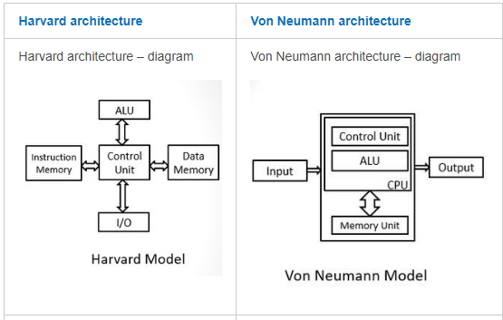

Slide 6
Von Neumann architecture
Based on stored program computer concept where instruction data and program data are stored in the same memory.
This design is still used in most computer produced todays .

Slide 7
Cache Memory
is a special very high-speed memory.
It is used to speed up and synchronizing with high-speed CPU.
Cache memory is costlier than main memory or disk memory but economical than CPU registers.
Cache memory is an extremely fast memory type that acts as a buffer between RAM and the CPU.
Cache memory is used to reduce the average time to access data from the Main memory.
The cache is a smaller and faster memory which stores copies of the data from frequently used main memory locations.

Slide 8
Instruction code
An instruction code is a group of bits that instruct the computer to perform a specific operation.
The operation code of an instruction is a group of bits that define operations such as addition, subtraction, shift, complement, etc
. An instruction must also include one or more operands, which indicate the registers and/or memory addresses from which data is taken or to which data is deposited.

Slide 9
Stored Program Organization
Simple way to organize a computer is to have one processor register and an instruction code format into two part
1.the first part specifies the operation to be performed
2.the second part specifies the address
The memory address tells the control where to find an operand in memory

Slide 10
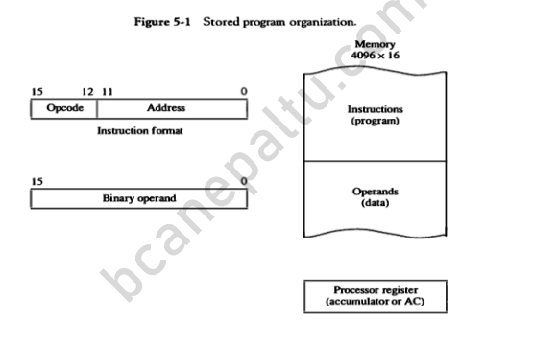
)

Slide 11
Direct and indirect addressing of basic computer
1. Direct Addressing Mode: In direct addressing mode, address field in the instruction contains the effective address of the operand and no intermediate memory access is required. 2. Indirect Addressing Mode: In Indirect addressing mode, address field in the instruction contains the memory location or register where effective address of operand is present. It requires two memory access

Slide 12
It consists of a 3-bit operation code ,a 12 bit address and an indirect address mode bit designated by I where ,the mode bit is 0 for the direct address and 1 for the indirect address.

Slide 13
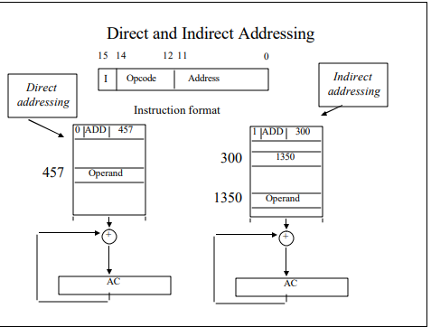

Slide 14
Computer register
Registers are a type of computer memory used to quickly accept, store, and transfer data and instructions that are being used immediately by the CPU. The registers used by the CPU are often termed as Processor registers.
A processor register may hold an instruction, a storage address, or any data

Slide 15
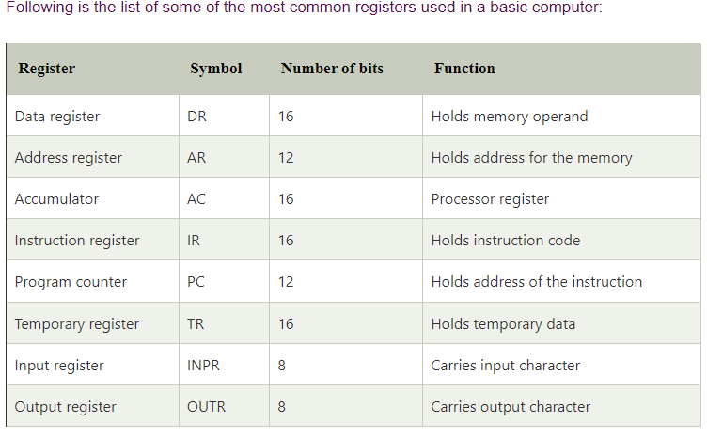

Slide 16
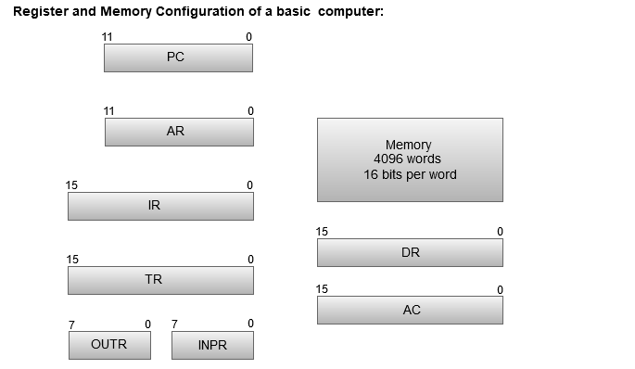
Basic computer register and memory

Slide 17
Computer register
The Memory unit has a capacity of 4096 words, and each word contains 16 bits.
The Data Register (DR) contains 16 bits which hold the operand read from the memory location.
The Memory Address Register (MAR) contains 12 bits which hold the address for the memory location.
The Program Counter (PC) also contains 12 bits which hold the address of the next instruction to be read from memory after the current instruction is executed.
The Accumulator (AC) register is a general purpose processing register.
The instruction read from memory is placed in the Instruction register (IR).
The Temporary Register (TR) is used for holding the temporary data during the processing.
The Input Registers (IR) holds the input characters given by the user.
The Output Registers (OR) holds the output after processing the input data.

Slide 18
The Common Bus
To avoid excessive wiring, memory and all the register are connected via a common bus.
• The specific output that is selected for the bus is determined by S2S1S0 .
• The register whose LD (Load) is enable receives the data from the bus.
• Registers can be incremented by setting the INR control input and can be cleared by setting the CLR control input.
• The Accumulator’s input must come via the Adder & Logic Circuit. This allows the Accumulator and Data Register to swap data simultaneously.
• The address of any memory location being accessed must be loaded in the Address Register.

Slide 19
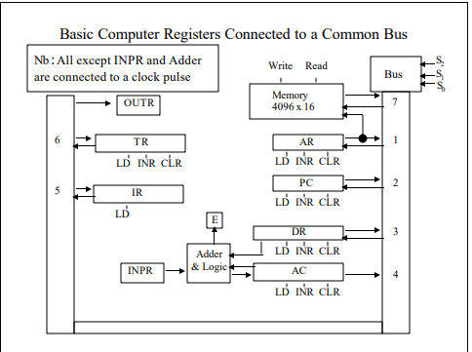

Slide 20
Timing and control
The timing for all registers in basic computer is controlled by master clock generator.
The clock pulse are applied to all the flip flop and register in the system including the flipflop and register in the control unit.
The clock pulse do not change the state of the register unless the register as enabled by the control signal.

Slide 21
Instruction cycle.
Time required to execute and fetch an entire instruction is called instruction cycle.
A program residing in the memory unit of computer consists of sequence of instruction.
The program is executed in the computer by going through a cycle for each instruction.
Each instruction cycle in turn is subdivided into sequence of sub cycle or phases
1Fetch and instruction from the memory.
2.Decode the instruction
3.Read the effective address from memory if the instruction has indirect address.
4. Execute the instruction.

Slide 22
Computer Instructions
Computer instructions are a set of machine language instructions that a particular processor understands and executes. A computer performs tasks on the basis of the instruction provided.
An instruction comprises of groups called fields. These fields include:
The Operation code (Opcode) field which specifies the operation to be performed.
The Address field which contains the location of the operand, i.e., register or memory location.
The Mode field which specifies how the operand will be located.

Slide 24
A basic computer has three instruction code formats which are:
Memory - reference instruction
Register - reference instruction
Input-Output instruction

Slide 25
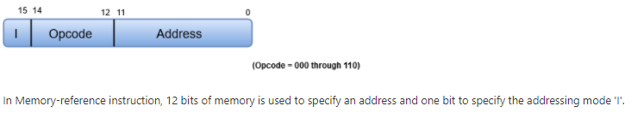
Memory - reference instruction

Slide 26
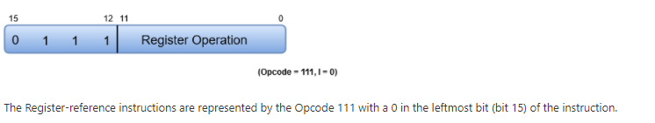
Register - reference instruction

Slide 27
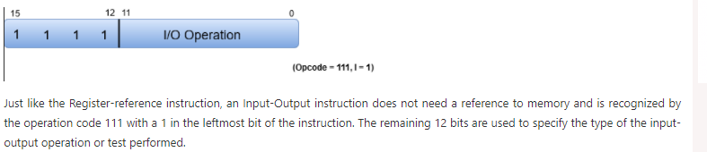
Input-Output instruction

Slide 28
Timing and control unit Hardwired control unit
Hardwired Control
The Hardwired Control organization involves the control logic to be implemented with gates, flip-flops, decoders, and other digital circuits.
The following image shows the block diagram of a Hardwired Control organization.

Slide 29
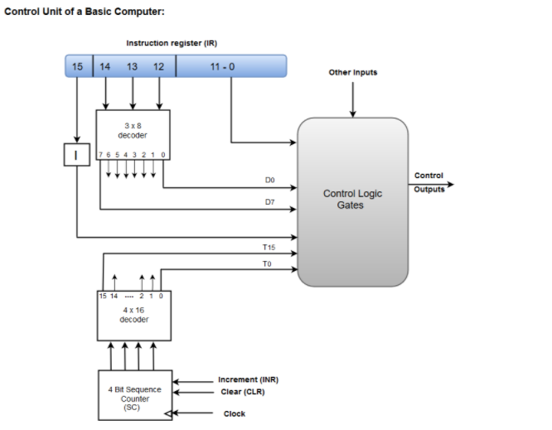

Slide 30
A Hard-wired Control consists of two decoders, a sequence counter, and a number of logic gates.
An instruction fetched from the memory unit is placed in the instruction register (IR).
The component of an instruction register includes; I bit, the operation code, and bits 0 through 11.
The operation code in bits 12 through 14 are coded with a 3 x 8 decoder.
The outputs of the decoder are designated by the symbols D0 through D7.
The operation code at bit 15 is transferred to a flip-flop designated by the symbol I.
The operation codes from Bits 0 through 11 are applied to the control logic gates.
The Sequence counter (SC) can count in binary from 0 through 15.

